Slide 1
UCSD Embedded RTOS Assignment 1
By
Hsuankai Chang
hsuankac@umich.edu

Slide 2
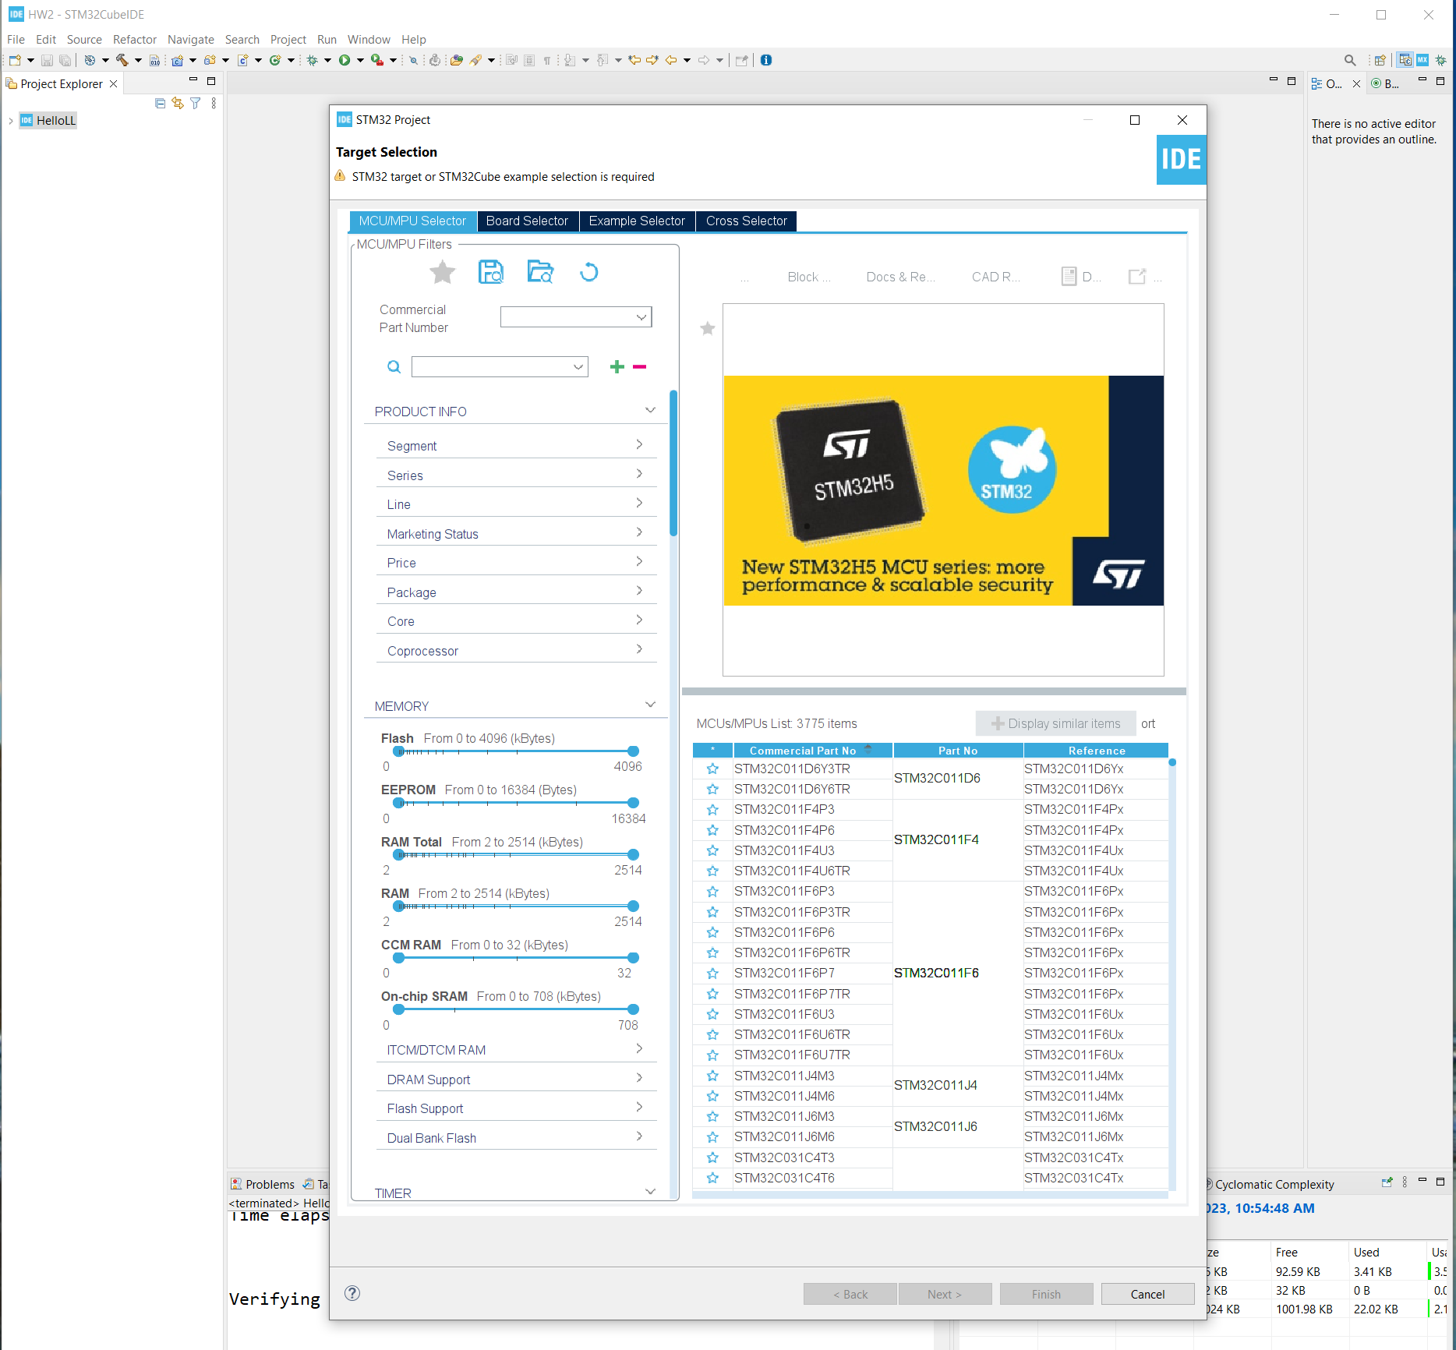
Step 1. Startup STM32CubeIDE and create new STM32 project

Slide 3
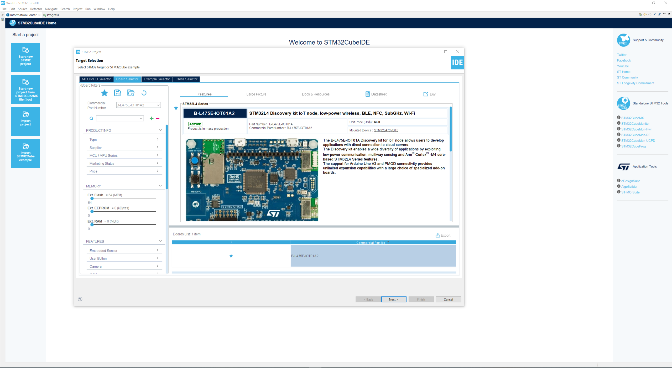
Step 2. Access board selector and type in the board you use, click Next

Slide 4
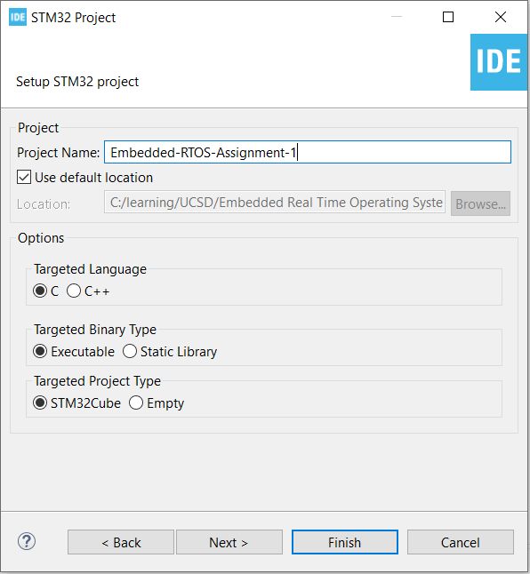
Step 3. Enter the project name then click Next

Slide 5
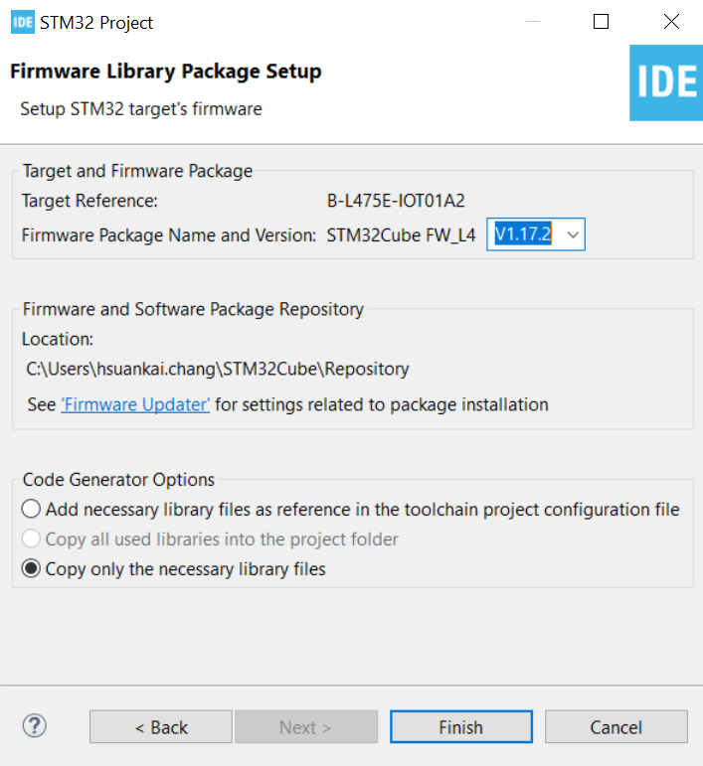
Step 4. See the firmware package name and version

Slide 6
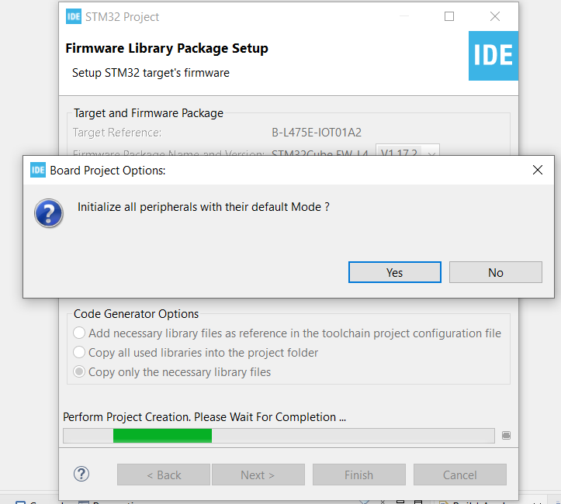
Step 5. Click yes to initialize all peripherals to default

Slide 7
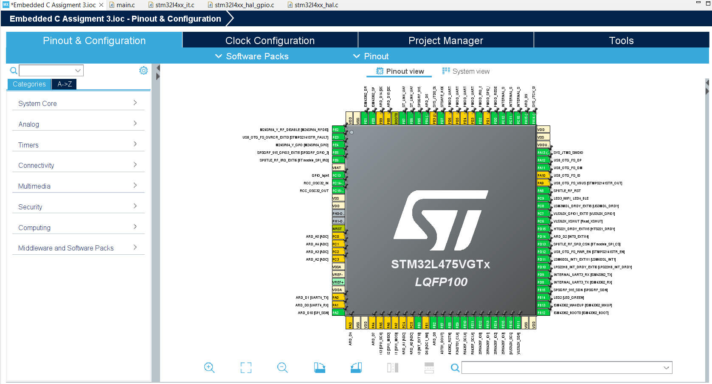
Step 6. When in .ioc file, click Pinout & Configurations

Slide 8
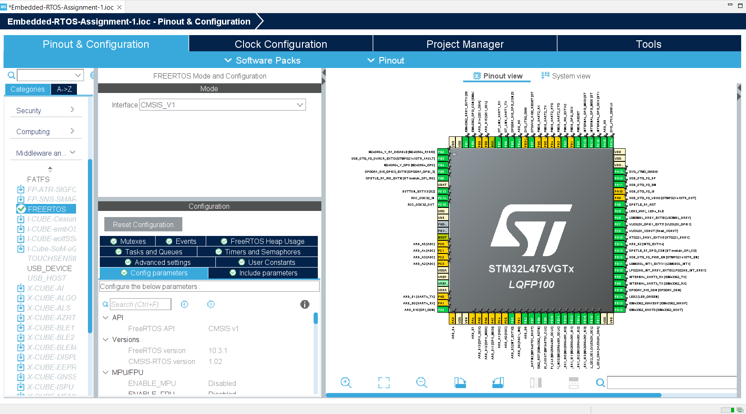
Step 7. Enable the FreeRTOS in middleware, leave all the settings as default

Slide 9
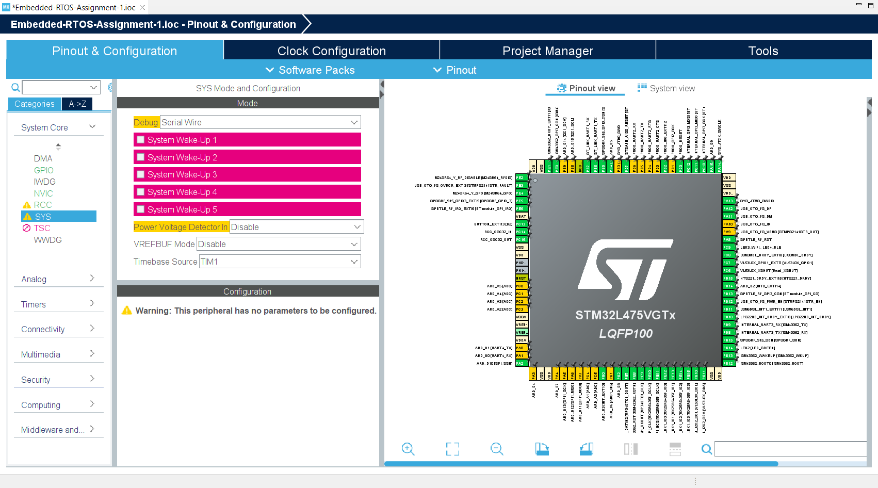
Step 8. Change Timebase from systick to TIM1

Slide 10
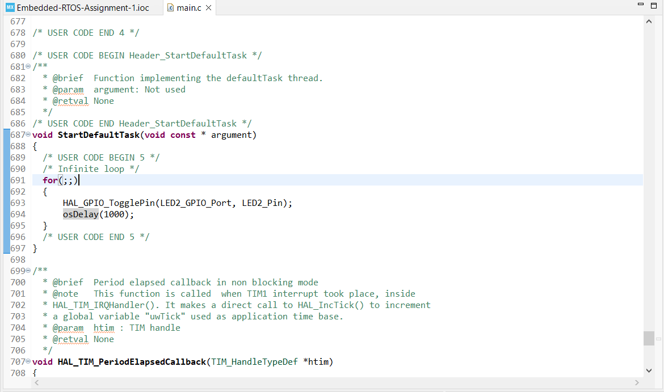
Step 9. Generate the code and add the LED2 toggle in default task

Slide 11
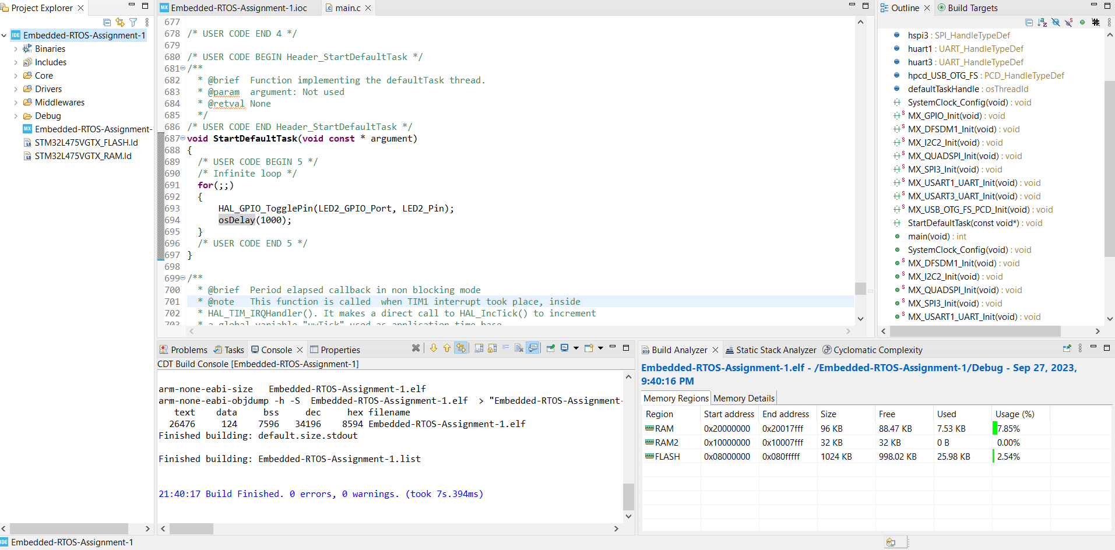
Step 10. Build and debug the code, you should see LED2 toggling

